Slide 1
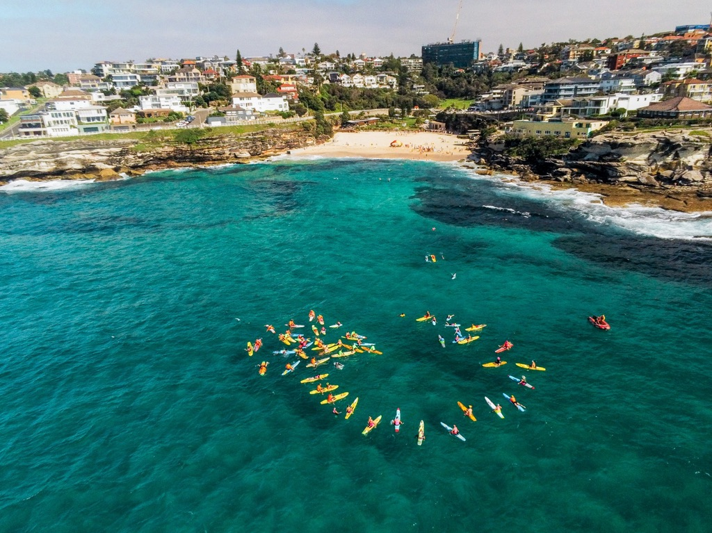
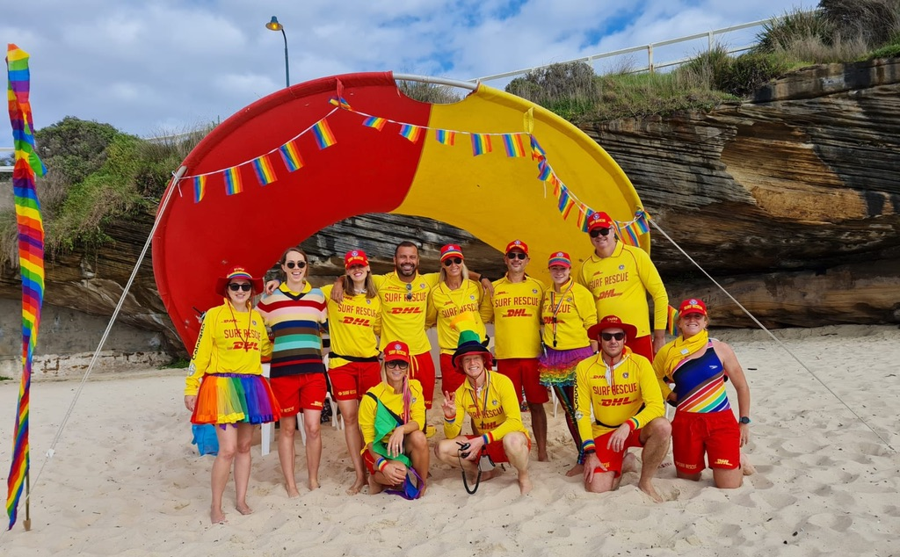
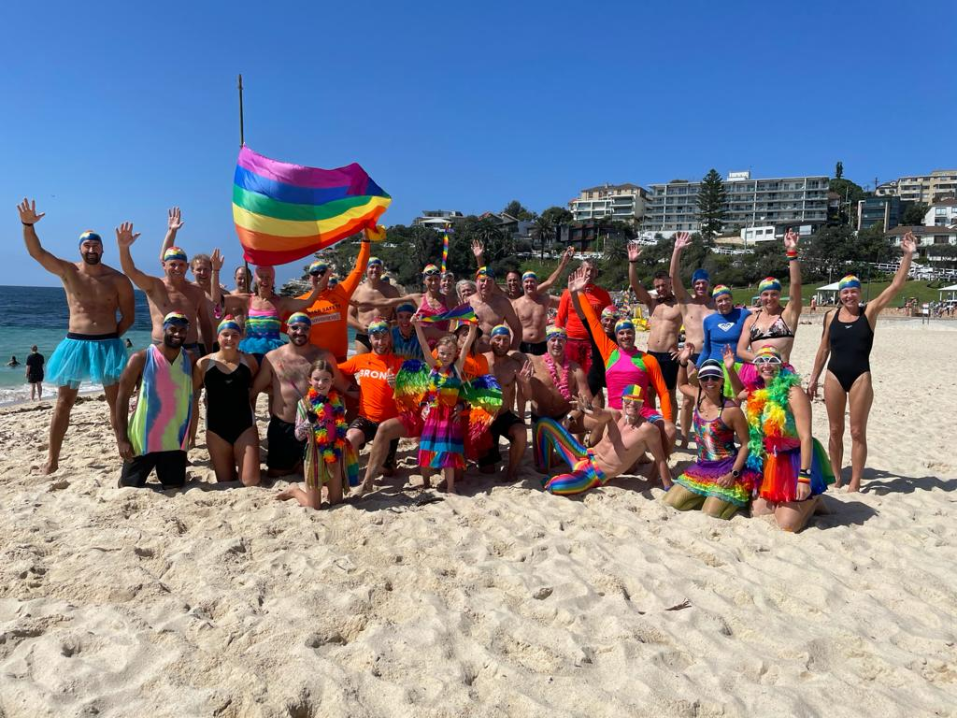
Rainbow Beaches 2022 – Dreaming of better days ahead…
Lifesavers with Pride (LWP) have been raising awareness within SLS of minorities, both within our membership plus promoting SLS as welcoming for new recruits (particularly our LGBTI members) since 2006. Throughout, LWP have represented SLS in various LGBTI festival events nationally to demonstrate this commitment to inclusion.
AS part of this, in 2020/21 LWP trialled our “Rainbow Beaches” events at select
Surf Clubs, with the theme that “everyone is welcome at the beach”, with clubs across the country indicating enthusiasm to participate.
Bronte, Tamarama, Dee Why & Coogee Surf Clubs adorned members, nippers, parents, patrols and beaches with rainbow colours. LWP provided a range of “rainbow” items and clubs added even more colour and fun. Participation on the day was broad-based and voluntary, while the reception from members and the general public was outstanding, as was resulting media coverage.
LWP has received requests to extend our Rainbow Beaches celebrations in 2022. Notwithstanding ongoing restrictions, we are now engaging with clubs, branches and partner organisations to take this unique message to more beaches this summer (Covid-permitting). Our approach is simple – provide a basic playbook & resources to make it easy for anyone to bring a rainbow to their beach, however they choose.
Over the coming months, we will be preparing simple collateral to help promote & organise successful Rainbow Beaches celebrations. So if you think your club could do with a rainbow celebration in 2022 (Covid-permitting), DM @lifesaverswithpride, email rainbowbeaches@lifesaverswithpride.com.au or call Ivan Power on 0427633891. In the meantime, stay safe.
Gary Driscoll, LWP Chairman

Slide 2
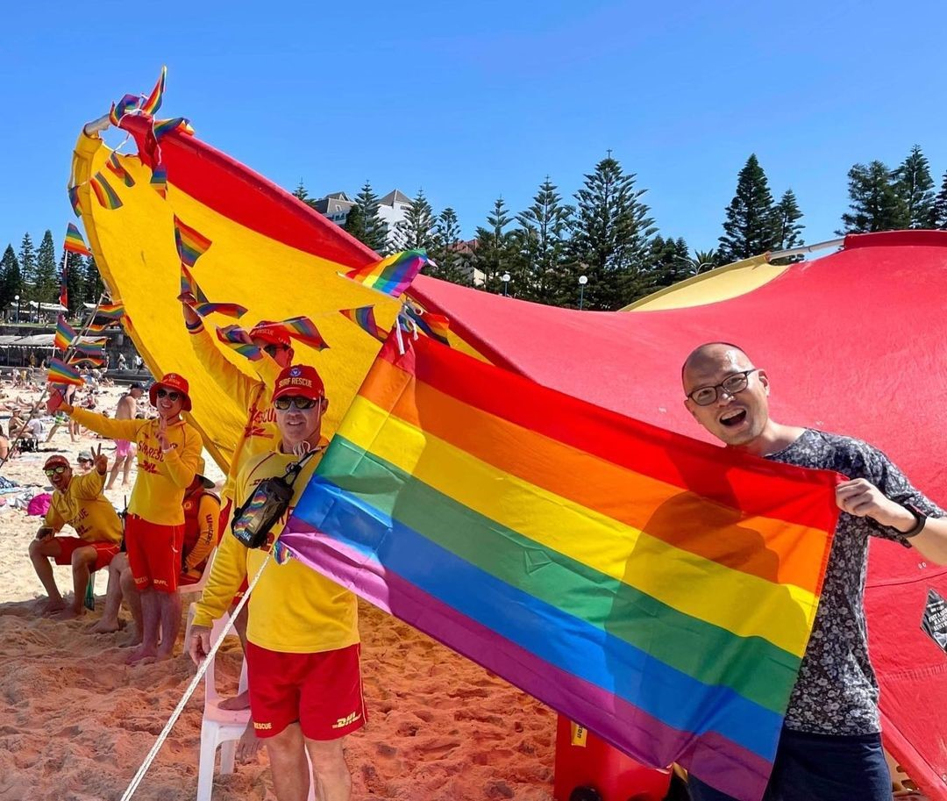
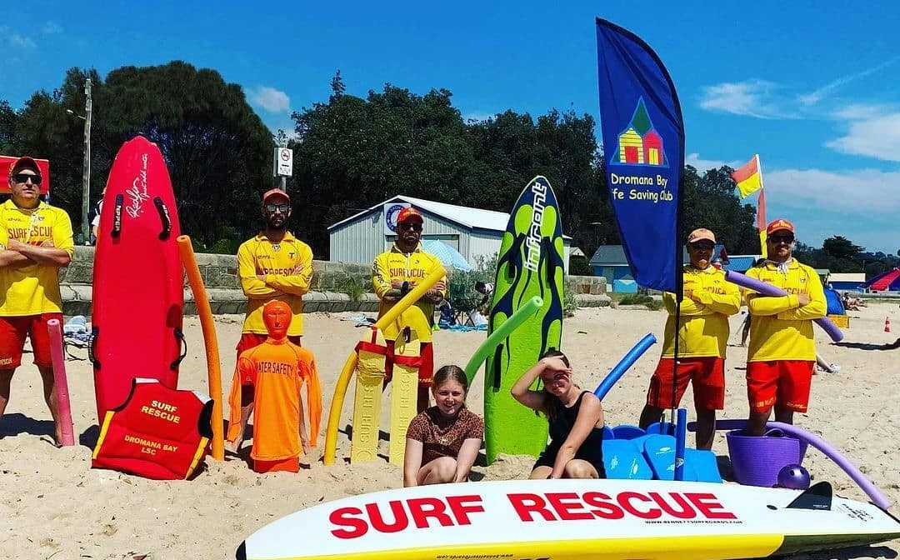
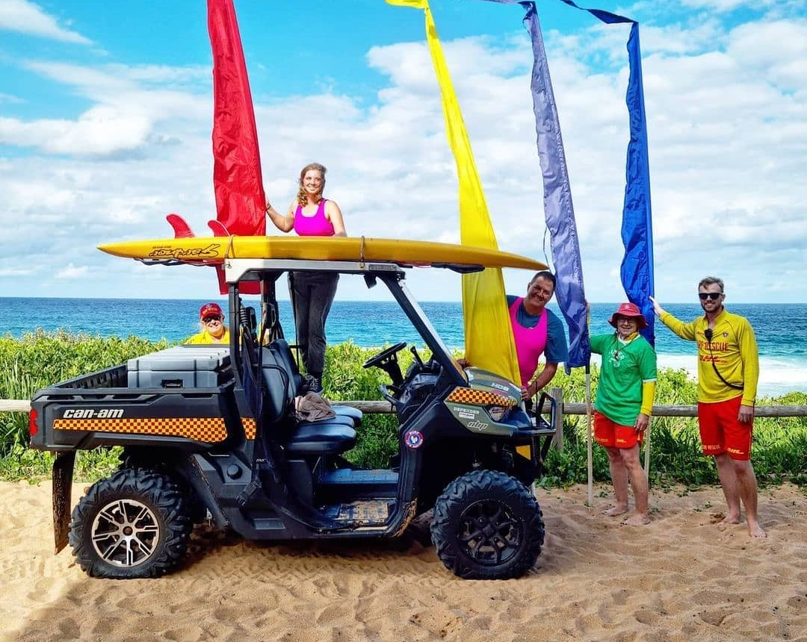
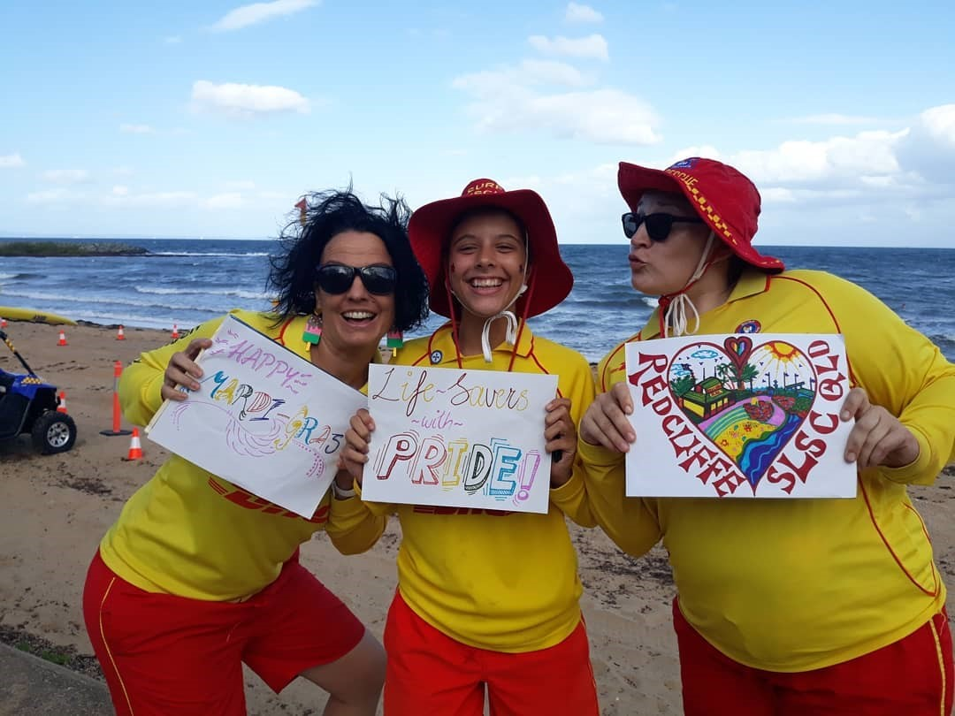
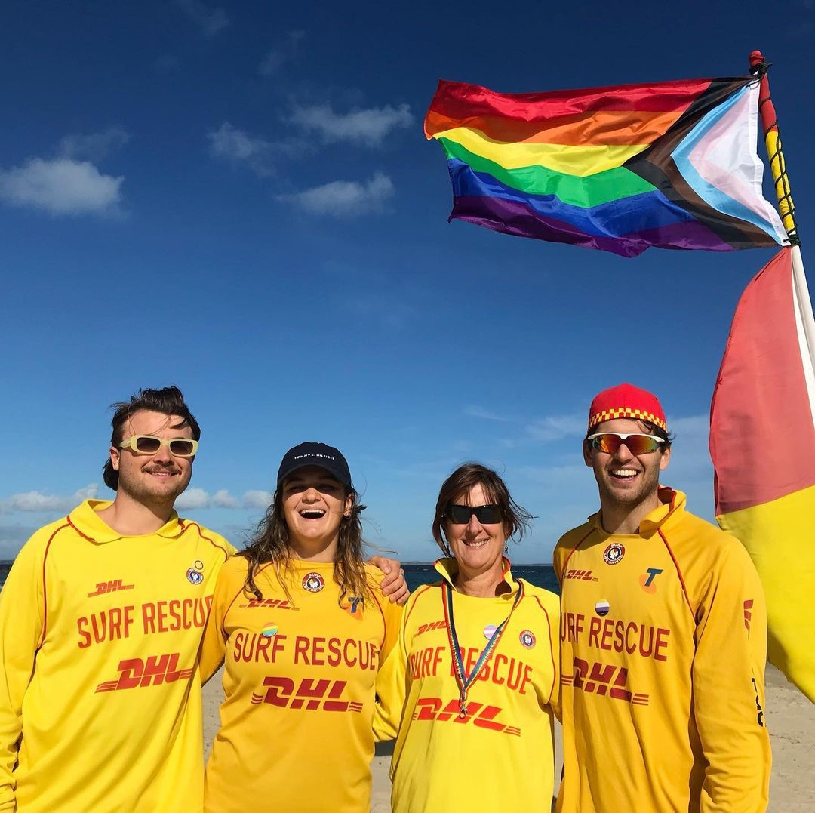
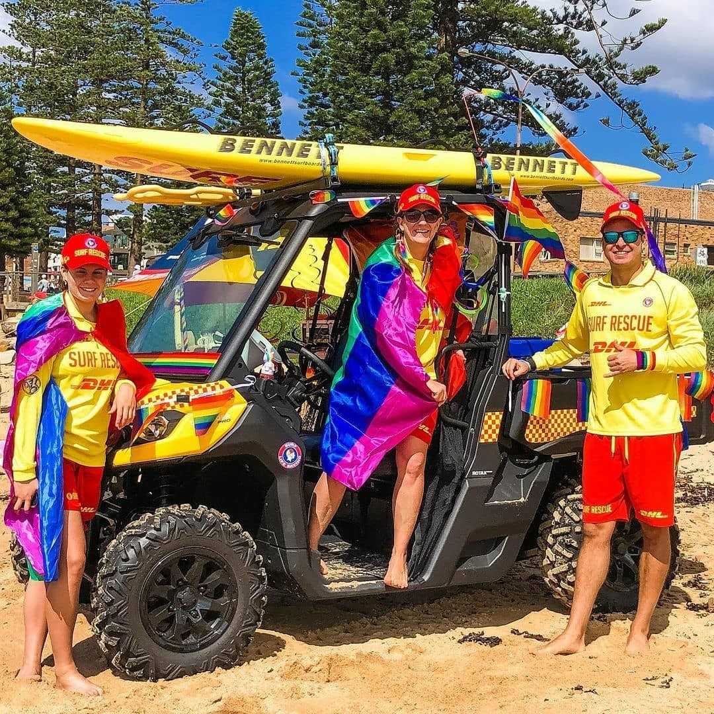
Coogee, NSW
Bronte, NSW
Lifesavers with Pride (LWP) have been promoting inclusion and diversity within SLS since 2006 for our members and new recruits (particularly the rainbow community).
LWP have now been promoting that everyone is welcome at the beach regardless of how they fit into the Diversity and Inclusion spectrum since our first Rainbow Beaches event in 2019 at Bronte Beach. Our Rainbow Beaches days celebrate that everyone is welcome on the beach, on patrol and in our clubs. Since then, clubs across the country have take up the initiative to show SLS as a place where everyone is welcome and can belong.
Bronte, Tamarama, Dee Why + Coogee Surf Clubs adorned members, nippers, parents, patrols and beaches with rainbow colours. Subsequently they were joined by Rainbow Patrols in Victoria, such as Fairhaven, Point Leo and Dromana Bay, while in NSW our reach went to Cronulla and Wanda and up to Freshwater, North Palm Beach and Avalon, whilst our friends at Brunswick, Byron and Yamba were unfortunately washed out in the floods.
Dromana Bay, Vic
Nth Palm Beach, NSW
Pt Leo, Vic
Redcliffe, Qld
Dee Why, NSW
ABN 20 398 158 298
Incorporated in New South Wales 2010 INC9894389

Slide 3
Coogee, NSW
Bronte, NSW
In each, LWP provide rainbow items and clubs added even more colour and fun. Participation is broad-based and voluntary, while the reception from members and the general public, as well as the media coverage, is outstanding. Activities like bake-offs, colour-in competitions, face painting or coloured swimwear events all add to the fun, or simple steps like images of coloured rescue boards, coloured towels or rainbow singage equally show our commitment.
LWP are keen to extend our Rainbow Beaches celebrations, due to enthusiastic clubs keen to join. We are now engaging with clubs, branches and partner organisations to take this message to more beaches this summer. Our approach is simple - make it easy for anyone to bring a rainbow to their beach, however and whenever they choose.
If you think your club could do with a rainbow celebration DM us on social media at @lifesaverswithpride or email rainbowbeaches@lifesaverswithpride.com.au..
Gary Driscoll, LWP Chair
Dromana Bay, Vic
Nth Palm Beach, NSW
Pt Leo, Vic
Redcliffe, Qld
Dee Why, NSW
ABN 20 398 158 298
Incorporated in New South Wales 2010 INC9894389

